Slide 1
COLOUR DETECTION

Slide 2
INTRODUCTION
Colour detection is the process of detecting the name of any colour.
Colour detection is necessary to recognize objects , it is also used as a tool in various image editing and drawing apps.

Slide 3
APPLICATIONS OF COLOUR DETECTION IN REAL LIFE
In self driving cars , detect the traffic signals.
Multiple colour detection is used in some industrial robots , to perform pick-and-place task to separate different coloured objects
This is an implementation of detecting multiple colours in real time using Python program

Slide 4
ABOUT THE PROJECT
In this colour detection Python project , we are going to build an application through which we can get the name of the colour automatically by clicking the particular area.
So for this we’ll have a data file that contains colour name and its value..
Before starting this project , we should be familiar with the python libraries OpenCV and Pandas.
OpenCV , Pandas and Numpy are the necessary Python packages for this colour detection project.

Slide 5
WORK PLAN
Selection/Process
Gathering of details discussing work to be done in coming days
Selecting modules to implement and begin work
Coding/problems
Division of work/modules to be dealt with
Going through each every code by the end of each week and try to merge each synatax
Final Look-up
Going through the work and making notes for further improvement to be done
Having a clear view i.e things to be done
finding sample to train for further colour detection
Trail/Error till motive of the work is clear
Making a step-wise analysis
Yeap basic-work ish-done making preps for betterment of the project

Slide 6
METHODOLOGY
Planning
Research and finding out Real-life problems
Analysis
Analyzing the work to be done / handing out roles for each members
Design
Creating the sequential syntax and walking through steps
Development
The coding for the project was developed using Python
IMPLEMENTATION
The work was carried out successfully with everyone having their chunks of success
SUPPORT
This project can further be extended to web-cam and street cams on further ado

Slide 7
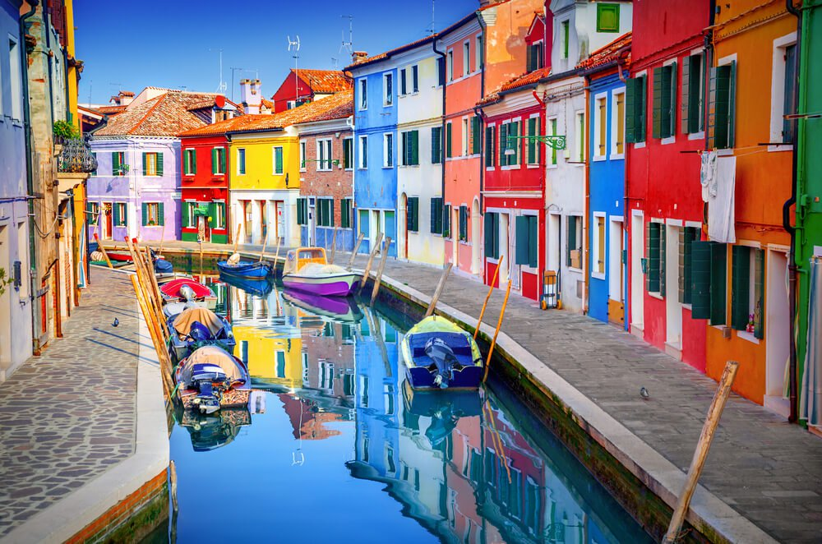

Implementation
STEP – 1
We started with selecting a sample image for experimenting and
csv.file containing color name , (R,G,B) values and hex values.
colors.csv

Slide 8
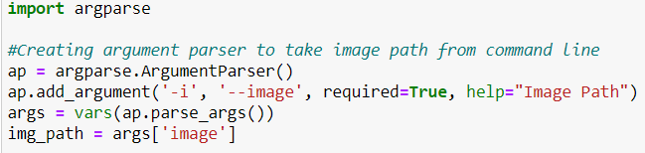
STEP – 2
We are using argparse library to create an argument parser. We can directly
give an image path from the command prompt.
The argparse module in Python helps create a program in a command
line- environment in a way that appears not only easy to code but also
improves interaction.

Slide 9
Steps for Using Argparse :
1] Creating a Parser : An ArgumentParser object that will store all the necessary
information that has to be passed from the python command-line.
2] Adding Arguments : A call to the add_argument()method. These information
tell ArgumentParser how to take arguments from the command-line and
turn them into objects.
3] Parsing Arguments : Calling parse_args() invokes appropriate action to produce a result.

Slide 10
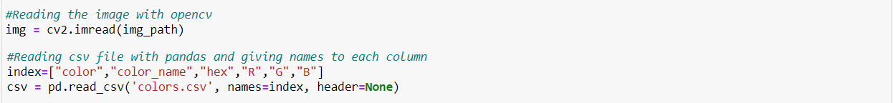
STEP – 3
We are using the cv2 module . Open-CV module will help in Image processing
like operation on images, videos using objects.
Here , we are taking the help of the Open-CV module for Reading an Image.
pd.read_csv() reads the CSV file and loads it into the pandas Data Frame.
We have assigned each column with a name for easy accessing.

Slide 11

STEP – 4
Creating another window to display the image selected for experimenting.
We are using the Open-CV module here for window creation.
STEP – 5
Open-CV helps us to control and manage different types of
Mouse Click events . We have chosen the left button click type along with
the callback functions which helps to improve the functionality of
mouse click event opted for.

Slide 12
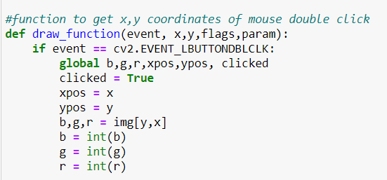
STEP – 6
An Image is a matrix of pixels. Each and every pixel is itself a matrix holding basic
information like color, depth, saturation, etc.
draw_function ( ) :
The function parameters have the event name (x,y) coordinates of the
mouse position.
In the function we ensure that the event is double clicked .
Then pass the color R, G, B as a tuple.
These values are calculated with the positions
of x , y co-ordinates.

Slide 13
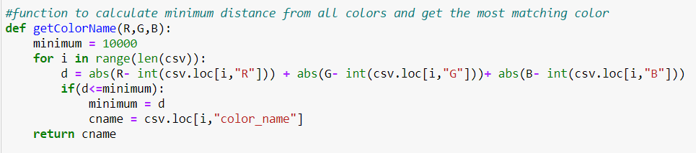
STEP – 7
We have another function in use with draw_function ( ) which will return
the color name from the R,G,B values in a tuple.
We calculate a distance to find how close we are to the color name and
choosing the minimum distance from the csv.file containing the color
names.

Slide 14
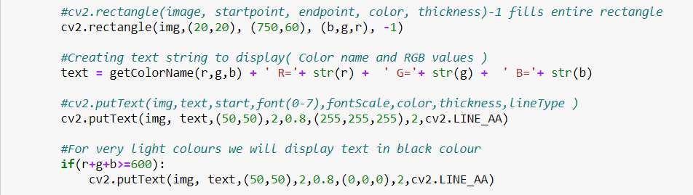
STEP – 8
Displaying the image on the window created by the Open-CV module.
We have used cv2.imshow(Input Image, Window name) to obtain our aim
of the project (i.e.)the color name from color.
Pixels of Image are boxed as rectangles by the function cv2.rectangle( )
and cv2.putText( ) used by us in the program. These boxes then display the
color name at the top of cv2.namedWindow(Window name).

Slide 15
STEP – 9
Ensure three things before running the code :
Python code file, sample image with .jpg/.png extensions and csv file are
in the same file directory.
>>Running the code in command prompt requires the below step to be followed :
python file path -i <add image path>

Slide 16
result
In this python project, we learned about colors and how we can extract color RGB values and the color name of a pixel. We learned how to handle events like double-clicking on the window and saw how to read CSV files with pandas and perform operations on data. This is used in numerous image editing and drawing apps

